Slide 1
File Systems

Slide 2
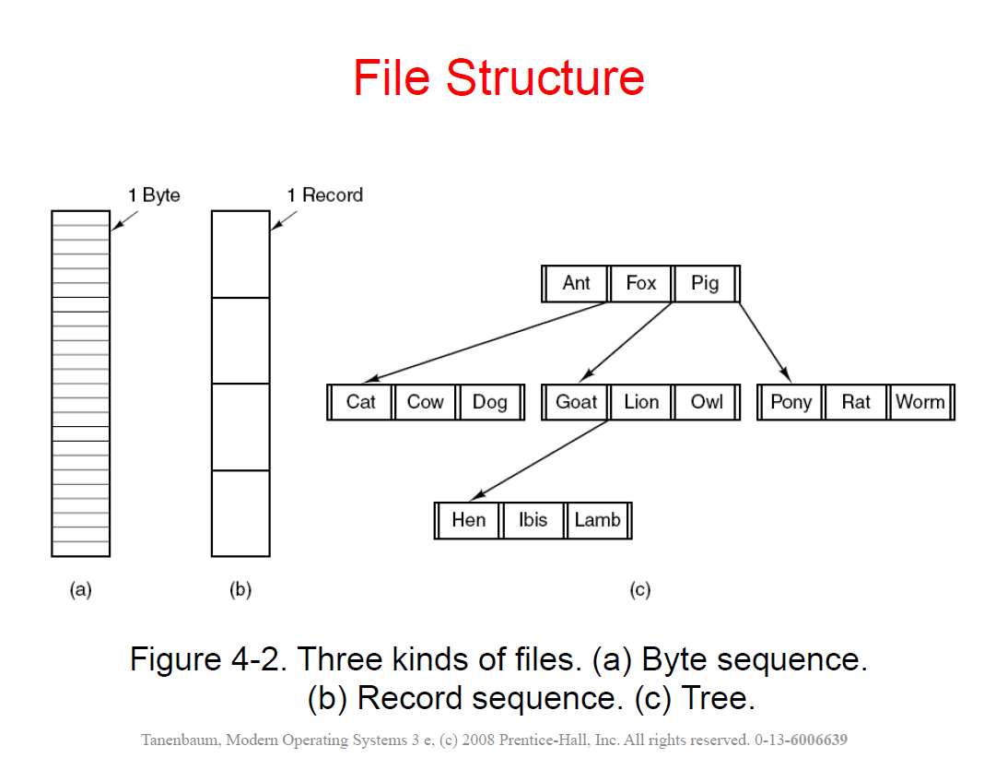

Slide 3
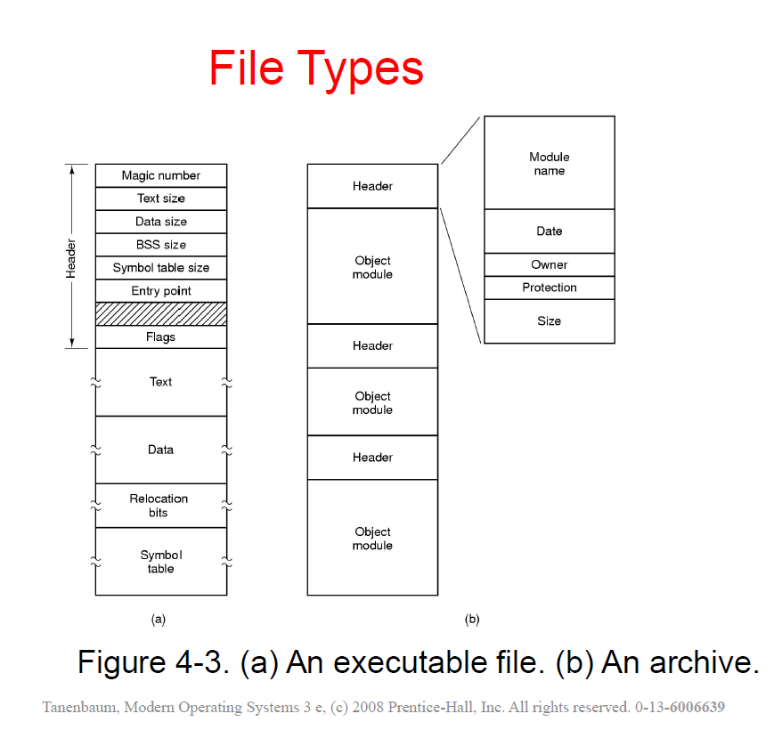

Slide 4
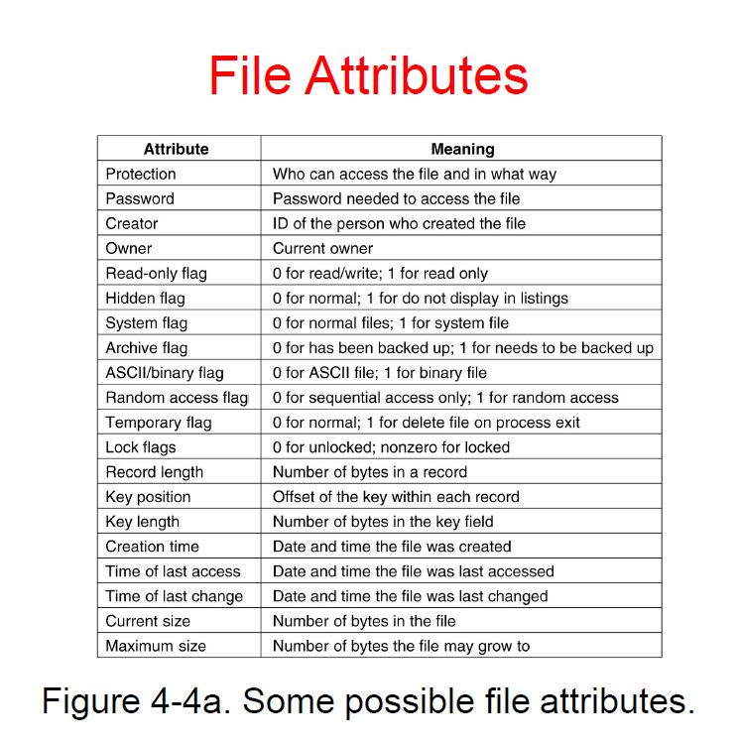

Slide 5
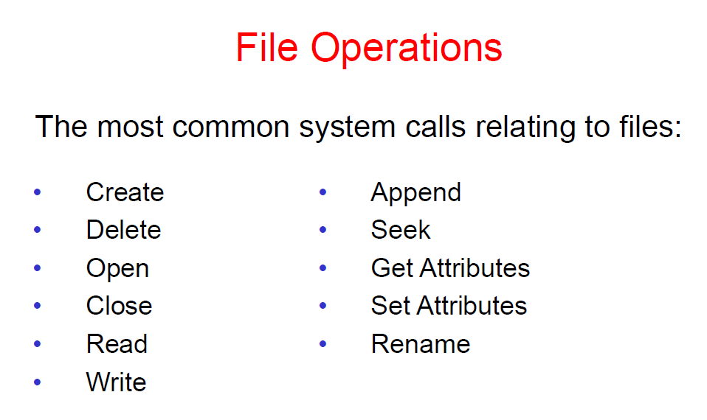

Slide 6
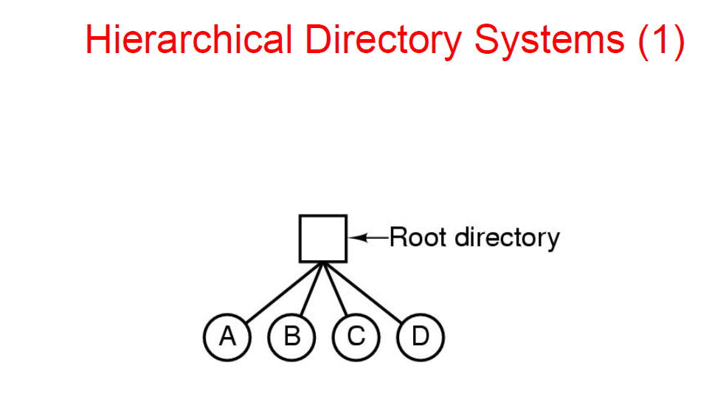

Slide 7
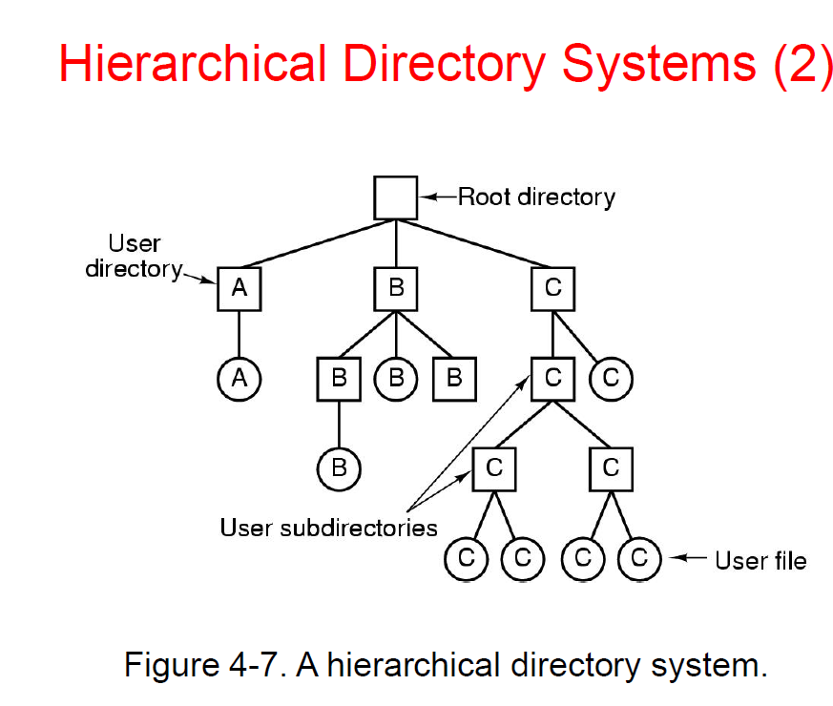

Slide 8
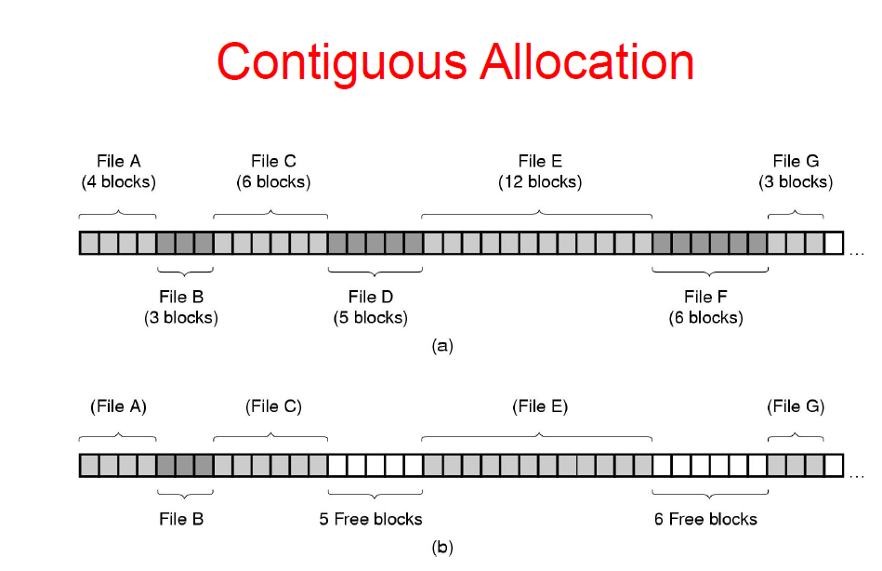
File Space Allocation
Random Access : Easier

Slide 9
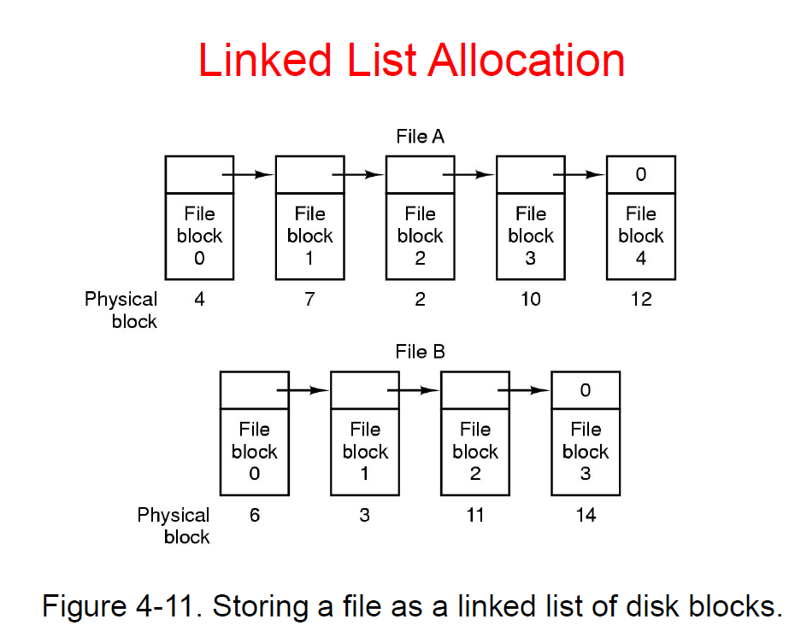
File Space Allocation
Random Access : ?

Slide 10
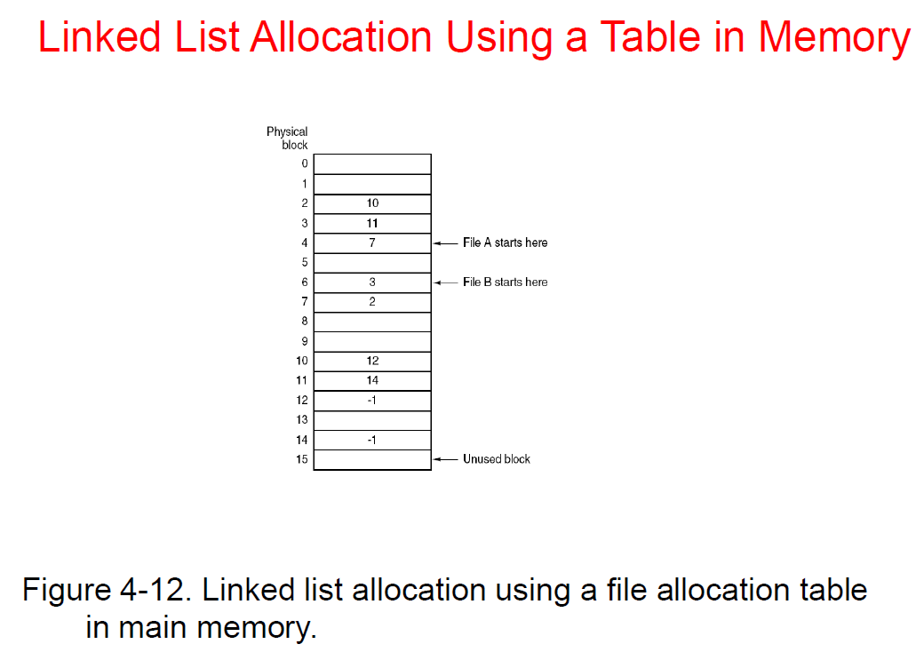
Random Access : ?

Slide 11
File Allocation Table (FAT)
Class Lecture

Slide 12
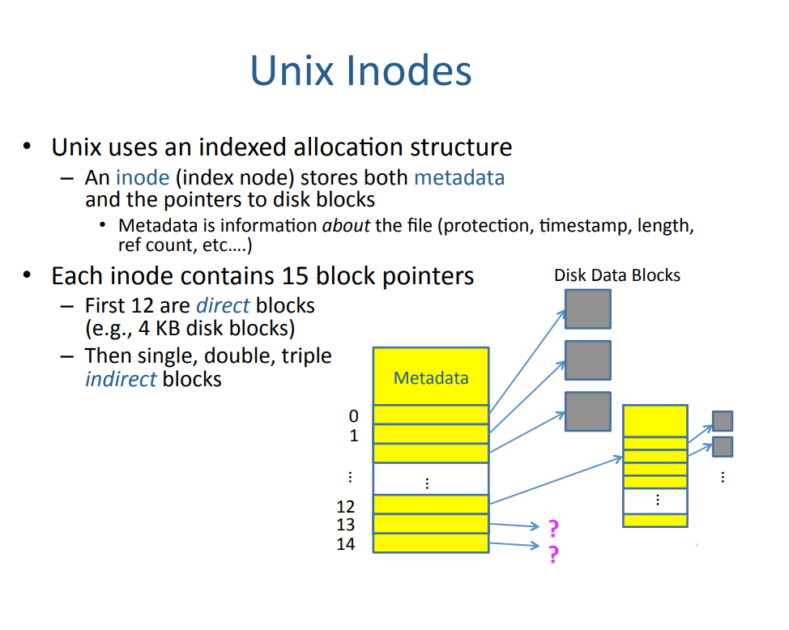
Inode Structure

Slide 13
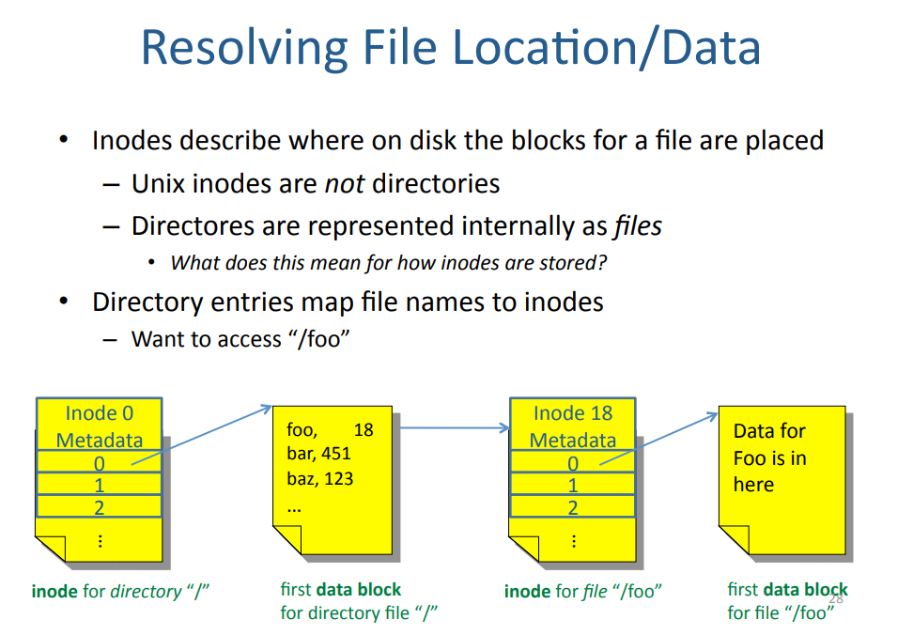

Slide 14
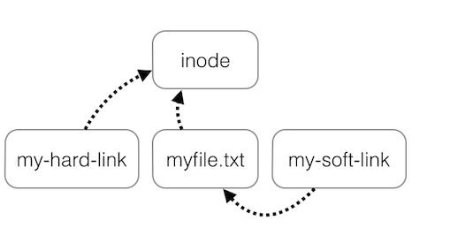
Hard Link Vs Softlink
Hard Link
ln f2 f2hl
Soft Link
ln –s f2 f2sl

